Slide 1
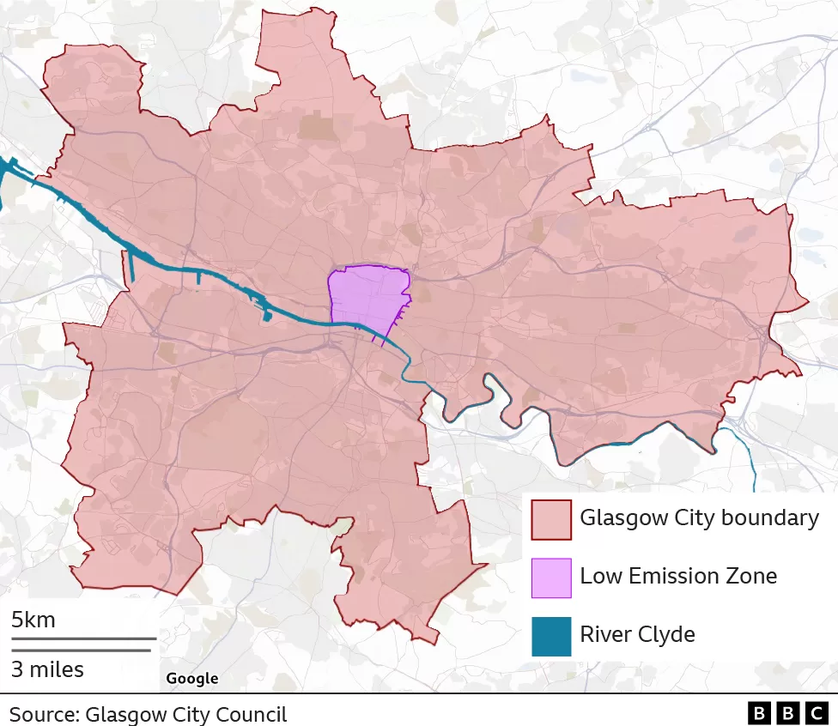
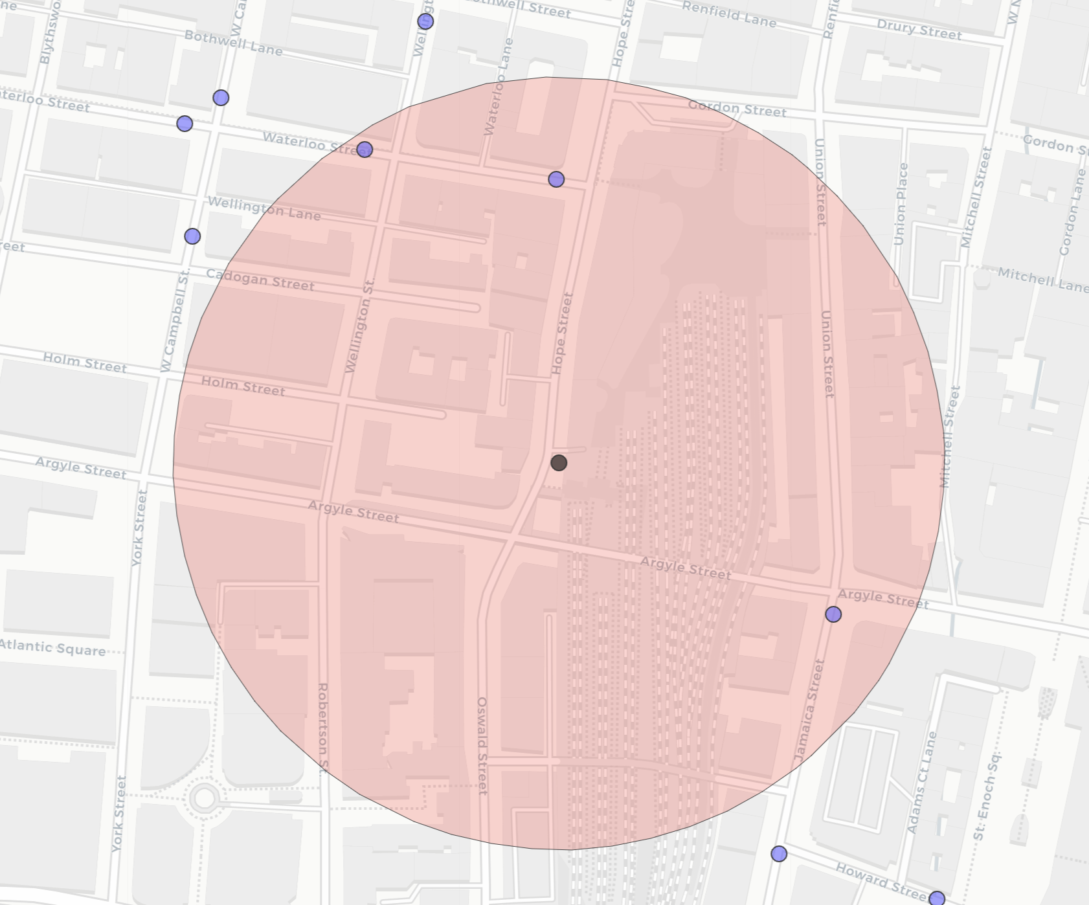
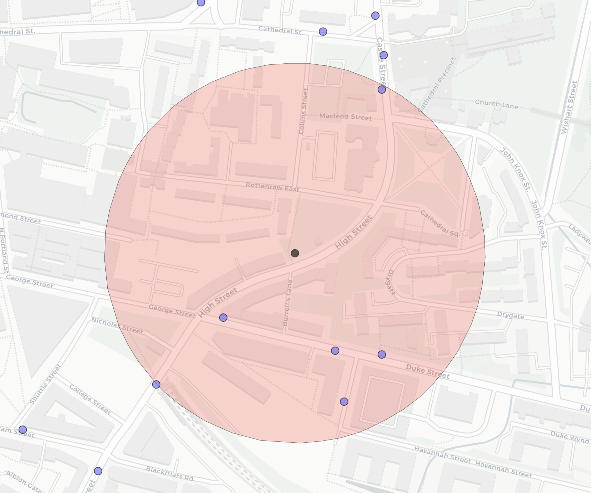


A
B
GA1571_Q: 146m
C
GA5371_C: 195m
GHSR
GLA4
GHSR
GLA4
GA2401_D: 162m
GG2001_S: 101m
Glasgow Hope St.
Glasgow High St.

Slide 2
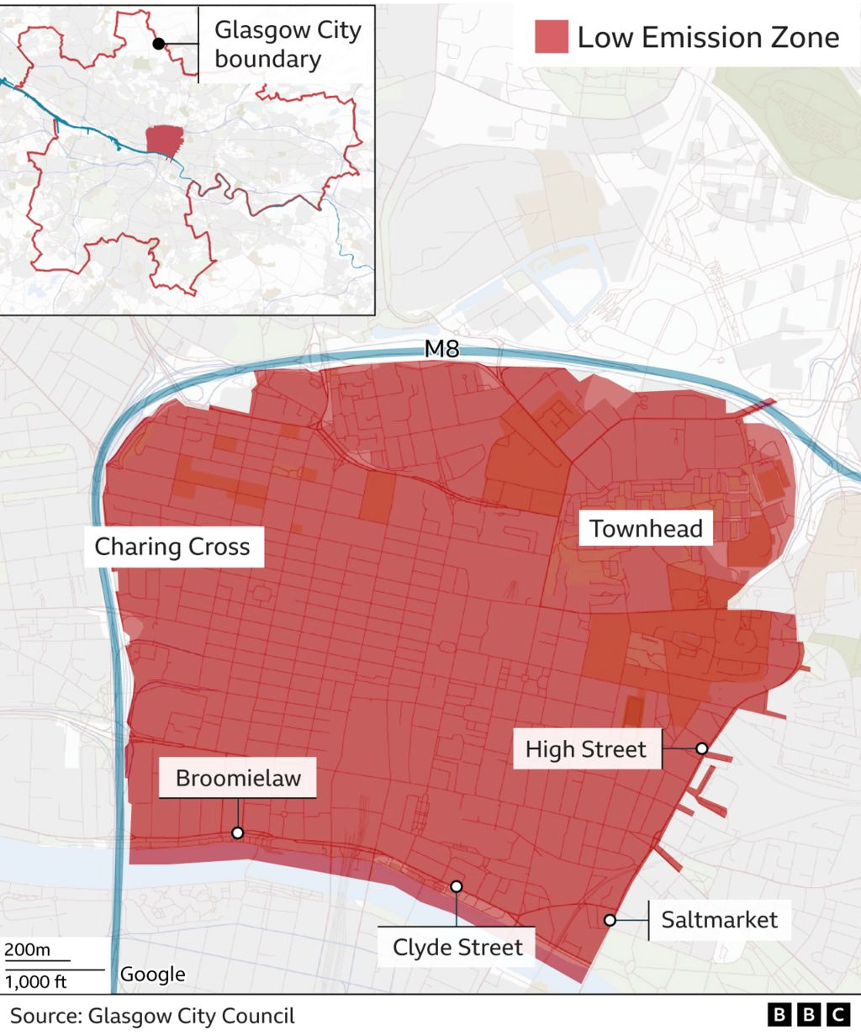
B
GA1571_Q: 146m
C
GA5371_C: 195m
A
GHSR
GHSR
GLA4
GA2401_D: 162m
GG2001_S: 101m
GLA4
Glasgow Hope St.
Glasgow High St.

